Slide 1

Memory Skills Group
Week 2 : Overview of Memory
Rebecca Niebieszczanski (Trainee Clinical Psychologist)
Kirsty Ellis (Assistant Psychologist)
Lesley Stewart (Consultant Clinical Neuropsychologist)
Revised 2021
Grace Sunerton (Assistant Psychologist)
Alice Roblin (Senior Clinical Psychologist)

Slide 2

Welcome!
Notes:
Welcome participants to the group
Explain that the group is for individuals who report difficulties with their memory
Important that we have realistic expectations that the group is not about ‘getting rid’ of our memory difficulties
The group will offer skills and information that will help us to manage these memory difficulties
2 hours with break

Slide 3




Housekeeping:
Notes:
Breaks – including toilet breaks
No recording of the session
Mobile phones on silent/vibrate to minimise distractions

Slide 4

Group Rules
Confidentiality
Respect
Share thoughts, ideas and experiences
Time keeping
Mobile phones
Notes:
Confidentiality – please respect each others information. Please discuss your own thoughts and materials with others but protect the confidentiality of members of the group by keeping discussions to how you feel and your own situation. Limits
Respect each other and allow each other space to talk and share different opinions
Please talk slowly and thoughtfully speaking one at a time so that everyone can hear and follow what is being said
Time keeping – please arrive on time so that the group can start promptly
Please switch mobile phones to silent
Is there anything that you would suggest could help the group to run smoothly?

Slide 5

Session Outline
Welcome and grounding exercise
Summary of last session
Review of out of session work
Exploring the memory process
Why do people experience memory difficulties?
Out of session work
Summary

Slide 6
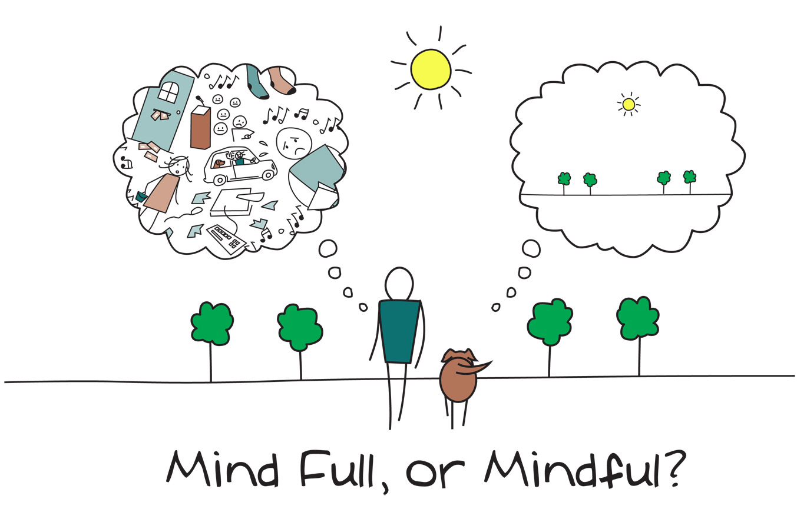
Mindfulness
Notes:
3-minute Mindful Breathing Meditation (Relieve Stress) - YouTube
As we said in the last session, when you come into each session there may be lots of things on your mind. You might have thoughts about what you’ve been doing, what you need to do, maybe some expectations or perhaps worries about what the group itself will be like. Our minds often wander and life is sometimes filled with stresses or worries.
To start off today, and at the beginning of our future sessions, we will carry out a brief breathing exercise. The aim of this is just to help us be more present ‘in the moment’, and give us some time to become more aware of our thoughts, feelings and any physical sensations.
As we’ll see later in the course, this can also support our cognitive functioning and help our memory along with promoting overall well-being. If you have difficulty focusing on the breath (e.g. due to breathing difficulties) then go at a pace that feels comfortable to you, stop the meditation or focus on another part of your body, such as your feet.
Below are some of the core principles of mindfulness:
The ‘being’ mode: Mindfulness says that often we are so caught up in these thoughts about the past and future (the ‘doing’ mode) that we end up not paying attention to what’s happening around us now (the ‘being’ mode).
Self-compassion: We often have so much compassion and empathy for others that we forget to have the same for ourselves. Mindfulness is about extending some of this kindness to ourselves.
Mindfulness can have a positive impact on lots of areas of our lives including:
Emotional wellbeing: becoming more aware of our unhelpful thoughts and feelings and distancing ourselves from these. This can help us to realise that thoughts are just that thoughts! We will talk more about this in sessions 5 and 6.
Physical wellbeing: Becoming more aware of our bodies can be very useful for managing stress and reducing the release of cortisols. This is because we’re often not even aware of the impact of stress on our bodies. We will also discuss this in more detail in another session
Cognitive functioning: Mindfulness can be used to help improve our attention. By becoming aware of our thoughts, feelings and physical sensations we can bring our attention back to the present moment and reduce how much time we spend in automatic pilot. This can actually also help us to train our attention and help us to process and encode information effectively.

Slide 7
Last Session: Summary
Hopes, fear, expectations
Overview and aims of the course
Cognitive abilities (attention, information processing, executive functioning and language abilities)
Goal setting
Home practice
Notes:
Home practice: how was it? Any particular difficulties? Anything from previous session? Any strategies noted down?

Slide 8
The Process of Memory
Attention
First you must focus on something; this includes listening and looking.
Notes:
The process of learning and remembering is quite complex and requires lots of different abilities and skills. This includes attention, information processing, encoding, storage and retrieval.
When we talk about memory or say my memory is bad, its easy to think of memory as one singular function. By being specific about what memory difficulties we notice and what aspects work better can help us to identify where in the process our main difficulties are. Therefore we’re able to come up with more effective and targeted strategies to support memory.

Slide 9

Attention
Notes:
Show videos Colour Changing Card Trick – YouTube
selective attention test - YouTube
After video, explain that if this process is interrupted or affected at any point, it can impact on our ability to recall information. E.g. if someone I having difficulty with their attention they might think they’re forgetting that information when in fact it’s not entering their minds in the first place.

Slide 10
The Process of Memory
Attention
First you must focus on something; this includes listening and looking.
Information Processing
Then you have to process and understand that information.
Notes:
The process of learning and remembering is quite complex and requires lots of different abilities and skills. This includes attention, information processing, encoding, storage and retrieval.
When we talk about memory or say my memory is bad, its easy to think of memory as one singular function. By being specific about what memory difficulties we notice and what aspects work better can help us to identify where in the process our main difficulties are. Therefore we’re able to come up with more effective and targeted strategies to support memory.

Slide 11
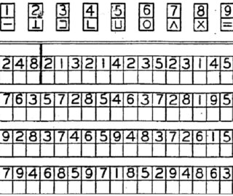
Information Processing

Slide 12
The Process of Memory
Attention
First you must focus on something; this includes listening and looking.
Information Processing
Then you have to process and understand that information.
Encoding
That information is then changed into a way that the brain can understand and store it.
Notes:
The process of learning and remembering is quite complex and requires lots of different abilities and skills. This includes attention, information processing, encoding, storage and retrieval.
When we talk about memory or say my memory is bad, its easy to think of memory as one singular function. By being specific about what memory difficulties we notice and what aspects work better can help us to identify where in the process our main difficulties are. Therefore we’re able to come up with more effective and targeted strategies to support memory.

Slide 13

Encoding
Encoding is like finding a place in the cabinet to put your memory
Notes:
When information comes into our memory system (from sensory input), it needs to be changed into a form that the system can cope with, so that it can be stored.
Think of this as similar to changing your money into a different currency when you travel from one country to another. For example, a word which is seen (in a book) may be stored if it is changed (encoded) into a sound or a meaning (i.e. semantic processing).
There are three main ways in which information can be encoded (changed):
1. Visual (picture)
2. Acoustic (sound)
3. Semantic (meaning)

Slide 14
The Process of Memory
Attention
First you must focus on something; this includes listening and looking.
Information Processing
Then you have to process and understand that information.
Encoding
That information is then changed into a way that the brain can understand and store it.
Storage
Once encoded, the information is stored into your memory.
Notes:
The process of learning and remembering is quite complex and requires lots of different abilities and skills. This includes attention, information processing, encoding, storage and retrieval.
When we talk about memory or say my memory is bad, its easy to think of memory as one singular function. By being specific about what memory difficulties we notice and what aspects work better can help us to identify where in the process our main difficulties are. Therefore we’re able to come up with more effective and targeted strategies to support memory.

Slide 15

Storage
Storage is keeping the memory in your ‘filing cabinet’
Notes:
This concerns the nature of memory stores, i.e., where the information is stored, how long the memory lasts for (duration), how much can be stored at any time (capacity) and what kind of information is held. The way we store information affects the way we retrieve it.
Short-term Memory - Most adults can store between 5 and 9 items in their short-term memory. Information can only be stored for a brief duration in STM (0-30 seconds).
Long-term Memory – can last a lifetime.

Slide 16
The Process of Memory
Attention
First you must focus on something; this includes listening and looking.
Information Processing
Then you have to process and understand that information.
Encoding
That information is then changed into a way that the brain can understand and store it.
Storage
Once encoded, the information is stored into your memory.
Retrieval
Once it has been stored, we must be able to pull the information back out; as and when we need it.
Notes:
The process of learning and remembering is quite complex and requires lots of different abilities and skills. This includes attention, information processing, encoding, storage and retrieval.
When we talk about memory or say my memory is bad, its easy to think of memory as one singular function. By being specific about what memory difficulties we notice and what aspects work better can help us to identify where in the process our main difficulties are. Therefore we’re able to come up with more effective and targeted strategies to support memory.

Slide 17

Retrieval
Retrieval is going into your ‘filing cabinet’ and picking the right memory to take out

Slide 18
The Process of Memory
Attention
First you must focus on something; this includes listening and looking.
Information Processing
Then you have to process and understand that information.
Encoding
That information is then changed into a way that the brain can understand and store it.
Storage
Once encoded, the information is stored into your memory.
Retrieval
Once it has been stored, we must be able to pull the information back out; as and when we need it.
Notes:
The process of learning and remembering is quite complex and requires lots of different abilities and skills. This includes attention, information processing, encoding, storage and retrieval.
When we talk about memory or say my memory is bad, its easy to think of memory as one singular function. By being specific about what memory difficulties we notice and what aspects work better can help us to identify where in the process our main difficulties are. Therefore we’re able to come up with more effective and targeted strategies to support memory.

Slide 19
break

Slide 20
Different types of memory
Working Memory: is your ability to temporarily hold information while manipulating it in your mind. An example of this is mental arithmetic
Immediate Memory or Short –Term Memory: is your ability to remember information for a few seconds or minutes such as remembering a phone number for long enough to dial it
Delayed or Long-Term Memory: refers to your memory for information over longer periods of time. For example your ability to remember things from years ago.

Slide 21


Different types of memory
Visual Memory: involves things that you have seen such as faces, objects and pictures.
Verbal Memory: is your memory for things you’ve heard or read.

Slide 22
What kind of difficulties might someone with memory difficulties experience?

Slide 23


I can remember things that people said years ago but I can’t seem to remember what people said or what happened yesterday
I’m able to recognise people’s faces but I find it hard to remember their names.
I can never seem to remember my appointments
I find it hard to remember what I just did, even if it was two minutes ago

Slide 24

Why do we experience memory difficulties?
A head injury or other injury to the brain
Some conditions such as epilepsy
Neurological conditions such as Multiple Sclerosis or Alzheimer’s disease
Stroke
Shortage of oxygen to the brain, for example because of a heart attack
Physical difficulties such as hearing loss or difficulties with vision
Some people notice difficulty recalling information as they get older.
Feeling tired or fatigued
Lifestyle choices
Stress
Low mood or anxiety
A difficult experience such as the death of a friend or relative.

Slide 25
How are people with memory difficulties affected?
Our mood or emotions. For example, some people might feel anxious, frustrated or low because of their difficulties
Our relationships – sometimes it can put strain on our relationships with friends or family
It might make us feel less motivated to do the things we need to do or enjoy in life
We might lose confidence to try new things
Work.

Slide 26
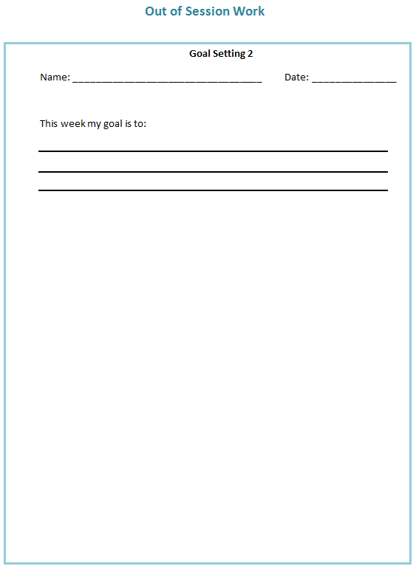
Out of Session Work
Weekly
SMART goals
Review in following session
Notes:
Helpful to think about own difficulties and to identify any strategies that are already providing to be useful, share them with the group

Slide 27

Summary
Mindfulness
Process of memory (attention, information processing, encoding, storage, retrieval)
Different types of memory
Why we experience memory difficulties
How memory difficulties can affect you
Out of session work

Slide 28
Thank you for attending
Grace Sunerton, Assistant Psychologist
Jessica Haselhurst, Trainee Clinical Psychologist
01782 275188
Notes:
Contact details if you are having difficulties with the programme. There will also be space to ask any questions and explore with us your difficulties within the group if you feel comfortable sharing these.

